Slide 1
Publix

Slide 2
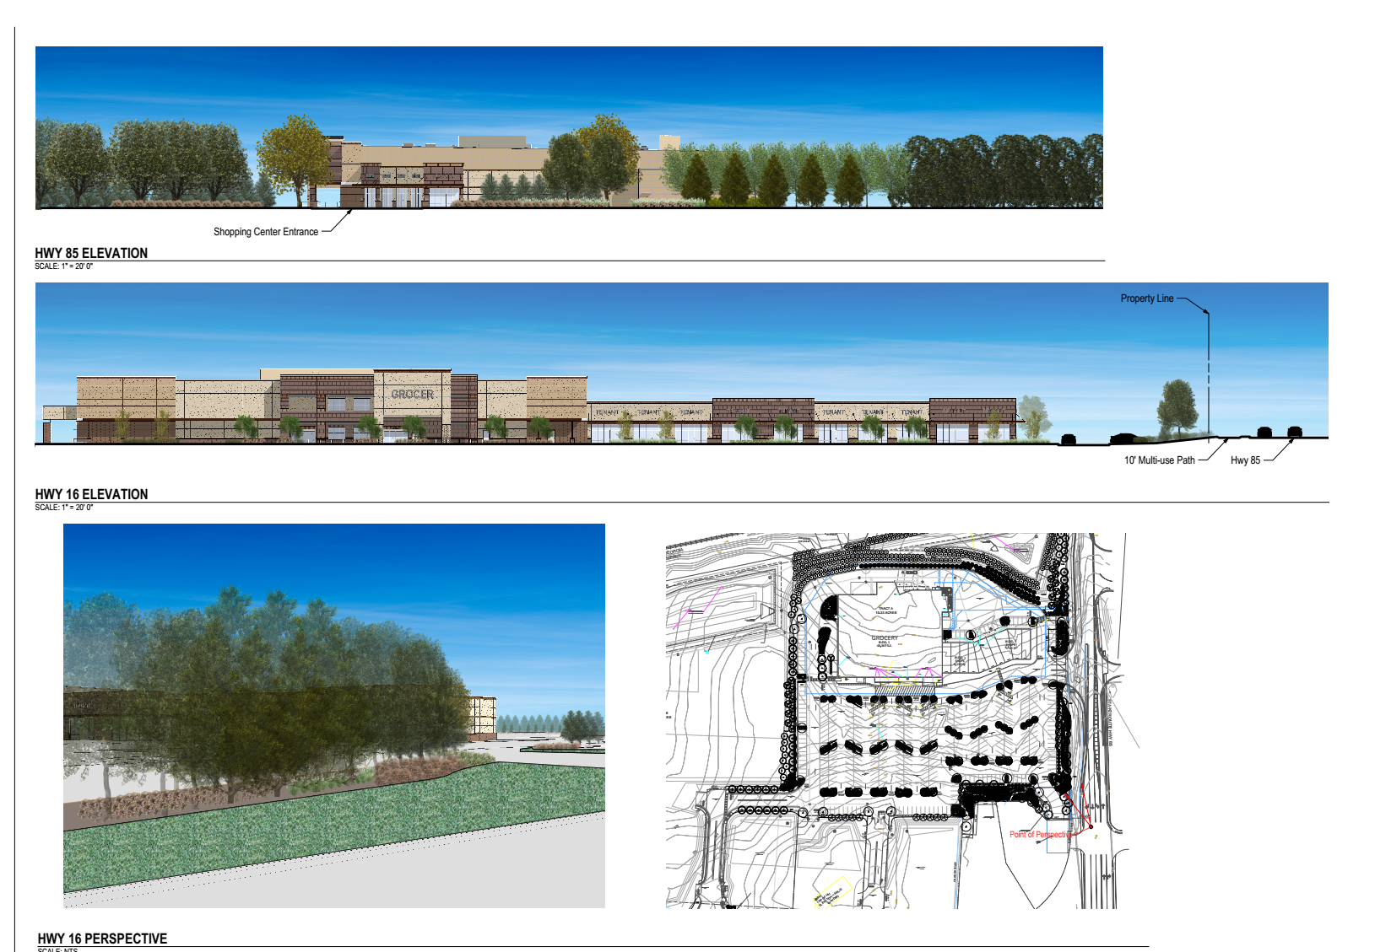
Notes:
Renderings

Slide 3
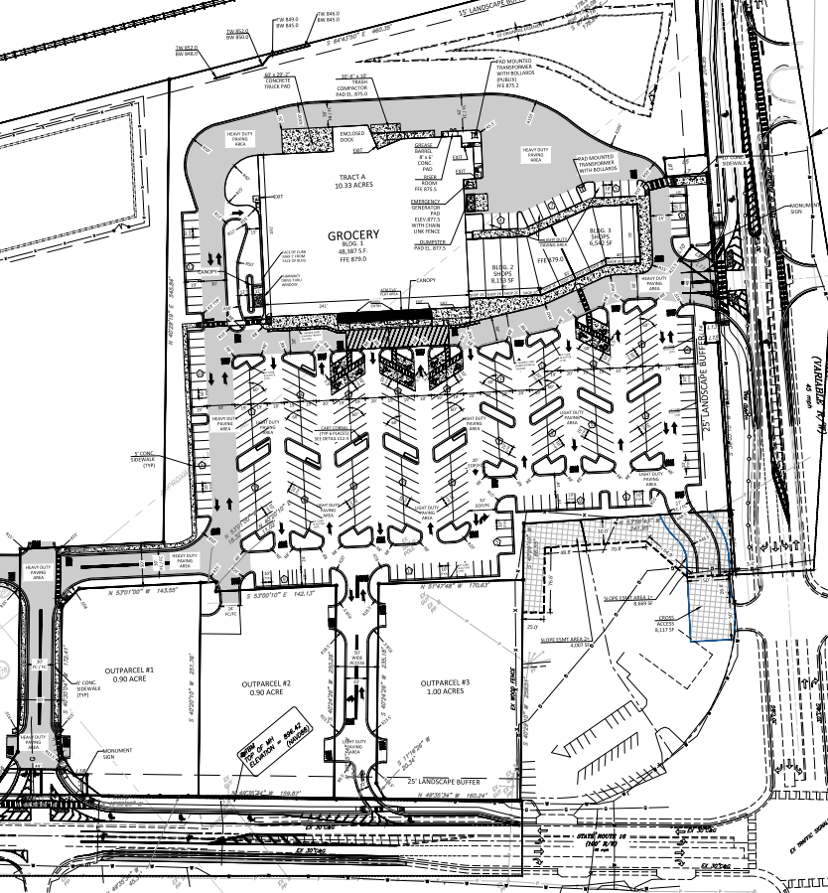
Notes:
Site Plan

Slide 4
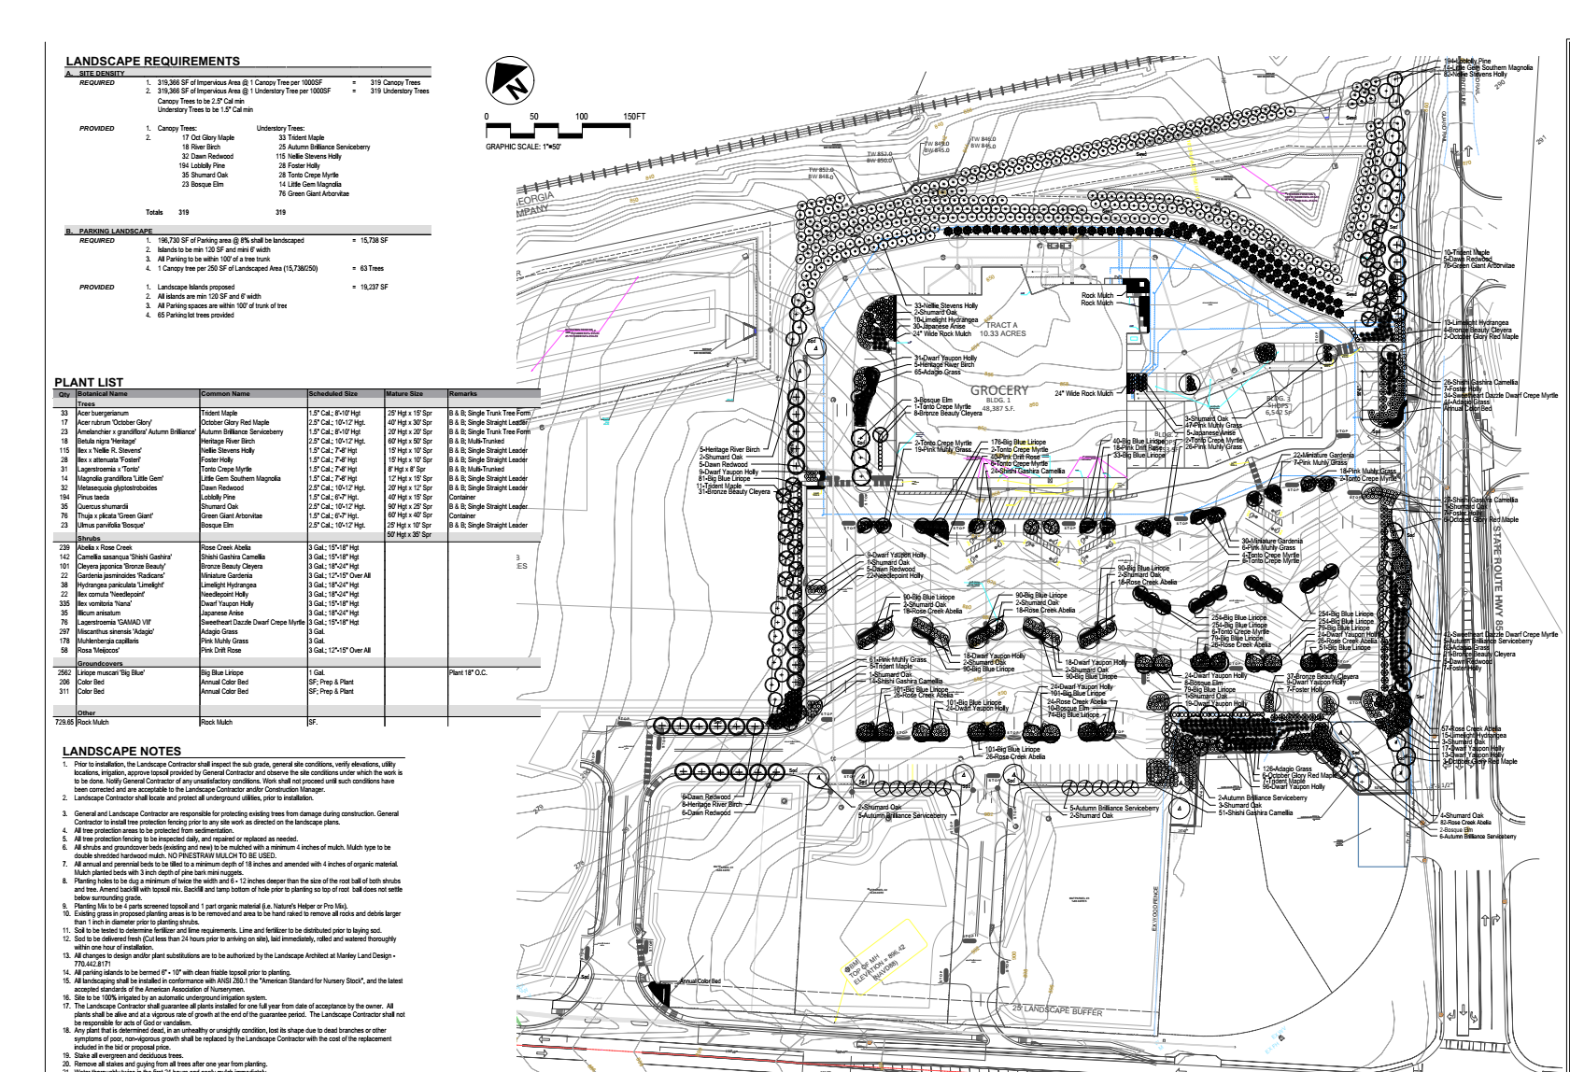
Notes:
Landscape plan

Slide 5
Notes:
If water is not properly, runoff of the roof it can cause roof damage and be a breeding ground for mosquitos in the summer months. This store will be a leader that will in turn bring other commercial business to the city. Currently the city does not have an optimal balance between commercial and residential and this type of business could bring a change to that ratio.
The staff does not see a problem with granting this variance.
Due to the design requirements set by the parent company, the staff does not see an issue with this design feature to allow for cornices less than one feet.
The staff is in complete agreement to have fencing around detention ponds. The fence must be vinyl coated if a chain link fence is used.
The applicant has expressed that the sidewalk will be stamped to add a decorative feature to it.

