Slide 1
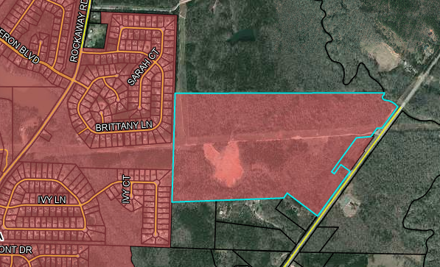
Newberry Development
168.52 ACRES
Notes:
153.82 Acers for rezone from R-40C to R-25C

Slide 2
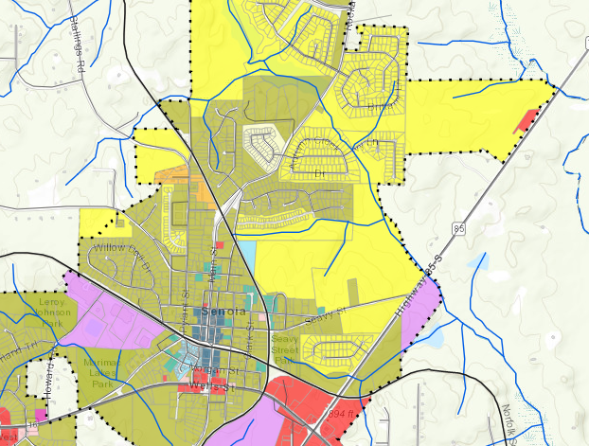
Current Zoning R-40C

Slide 3
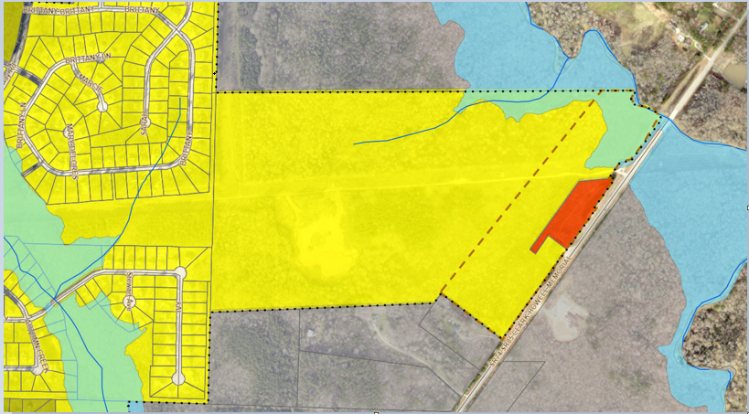
Flood Plain Map / Future Land Use= Residential

Slide 4
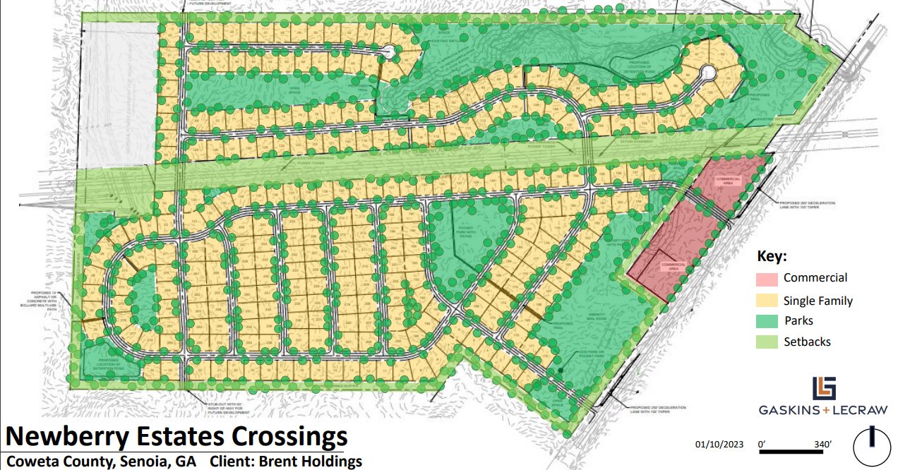

Slide 5
Proposed Newberry Development 168.52 ACERS
Current Zoning R-40C (.9) 151 Total Units
Front 25’ Sides 10’ Rear 25’ (Green Space 40%)
Proposed Zoning R-25C (2.5) 421 Total Units
Front 20’ Side 7.5’ Rear 20’ (Green Space 25% -10% Buildable)
Orig. Proposed Density R-25C (1.77) 298 Total Units
New Proposed Density R-25C (1.65) 278 Total Units

Slide 6
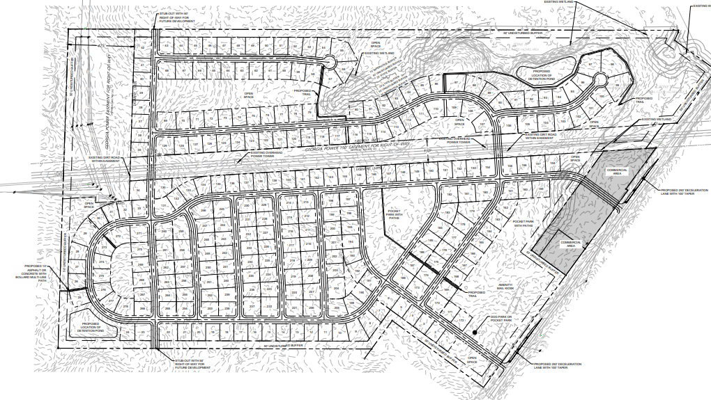

Slide 7
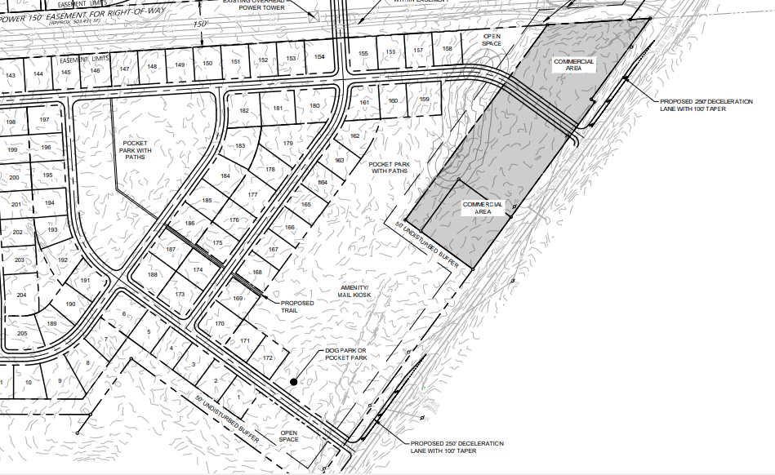

Slide 8
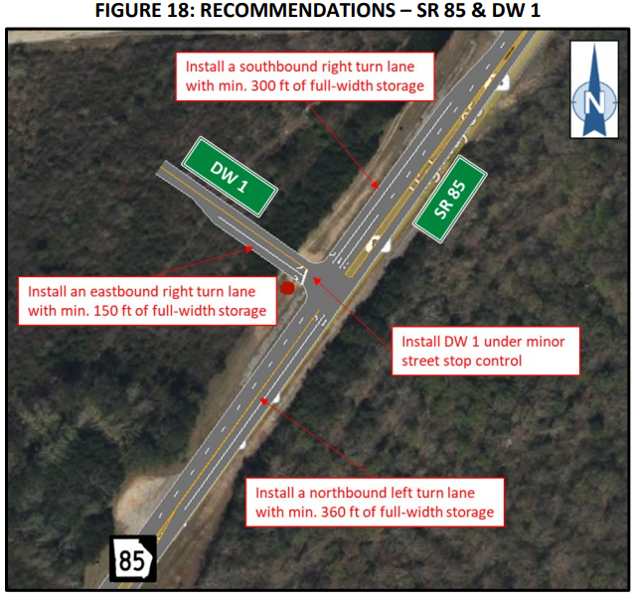

Slide 9
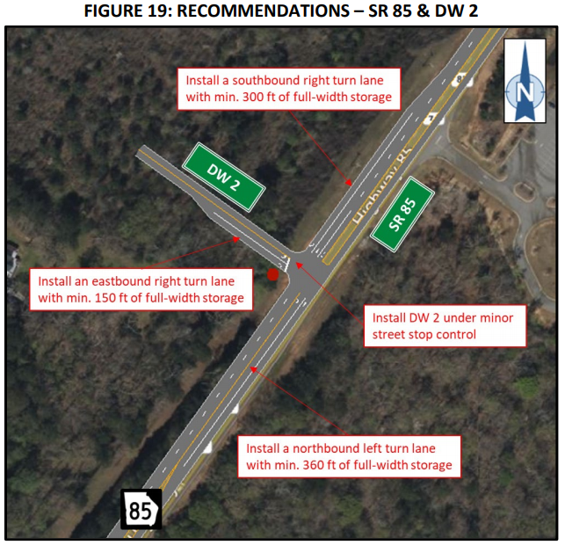

Slide 10
