Slide 1
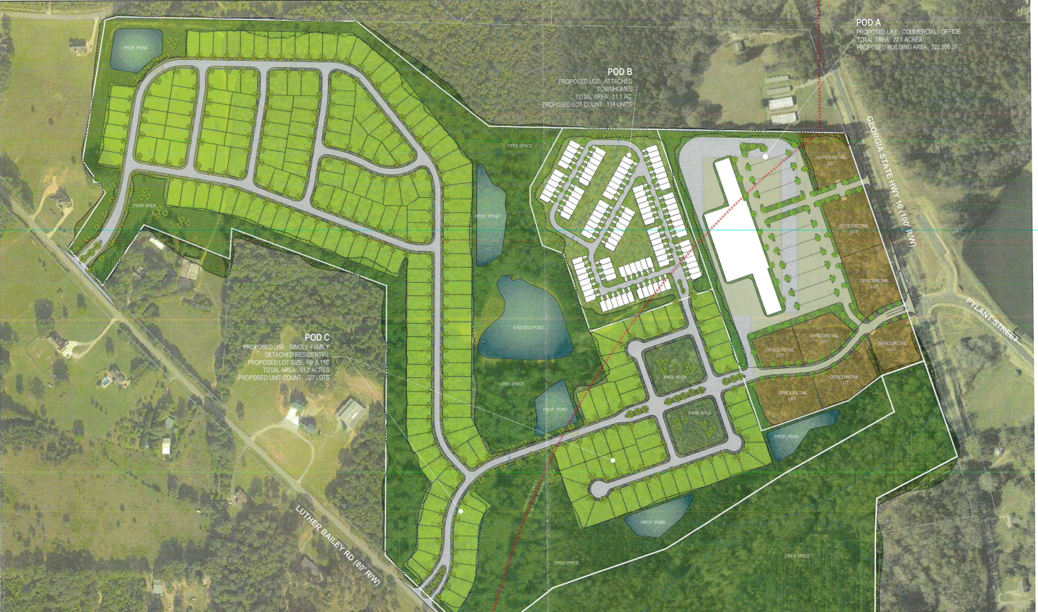
Lindsey Annexation
Total Acres 152 Acres
Types of Zoning
R-25c
GC
MF
Greenspace , as a requirement of the r-25C

Slide 2
Future Character Map
Traditional Residential
Intown Cooridor
Implementation strategies:
Encourage the use of historic tax incentives for the rehabilitation of structures.
Enforcement of the historic overlay guidelines and HPC design review
Promote infill that is architecturally appropriate and of compatible with the neighborhood
Educate new and existing residents of HPC design guidelines
Encourage traditional neighborhood design principles
Implementation strategies:
Require streetscape plans for new development
Require underground utilities
Encourage public street access and rear parking
Appropriate building design
Encourage two and three story structures
Gateway signage
Encourage development to locate close to roadway

Slide 3
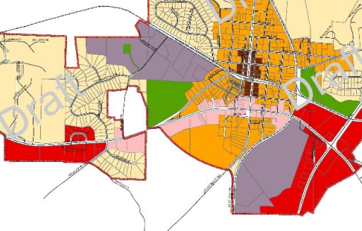
Future Character Map

Slide 4
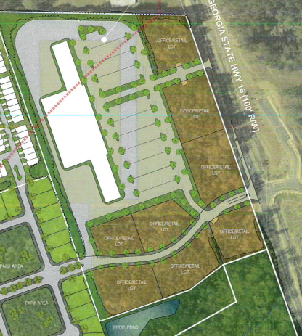
Commercial
Total Lots - 9
4 lots will need to comply with the
  Downtown 16 Overlay
  Architecture
  Landscaping
  Parking
Creates walkability to residential a desired effect for the R25C zoning.

Slide 5
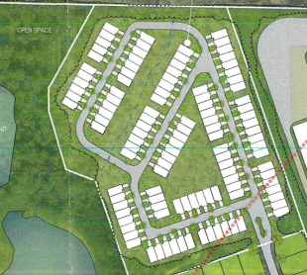
Townhomes
Current regulations allow for 4 townhomes per acre- the project is showing 11.1 per acre ( Variance is requested )

Slide 6
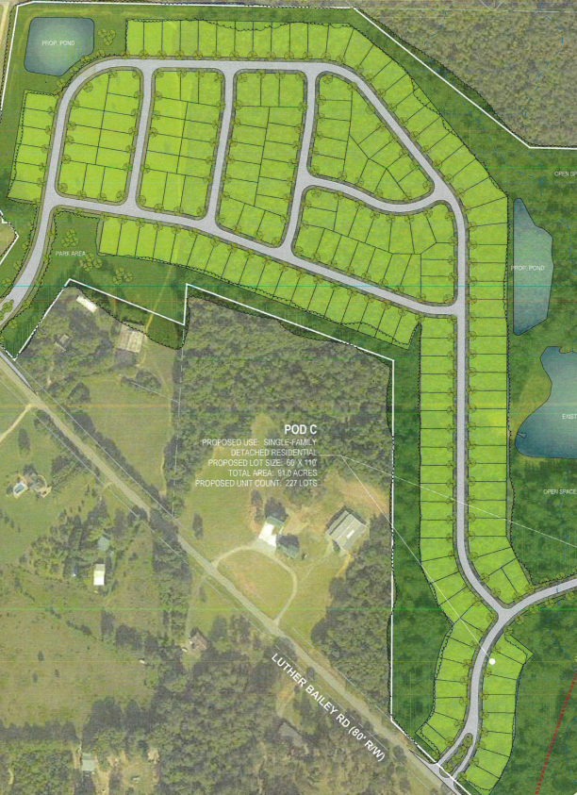
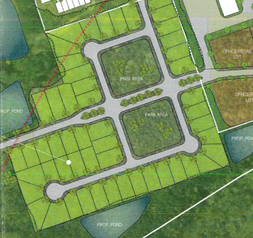
Residential R25-C

Slide 7
R-25C
Requesting 227 lots
Created three park areas
Two landscaped entrances from Luther Bailey Rd.
Meets development standards of 2.5 home per acre.
Multi use trail to grant citizens an access point for walking, biking and golf carts to move through out the city. Reducing dependence of an automobile.

Slide 8
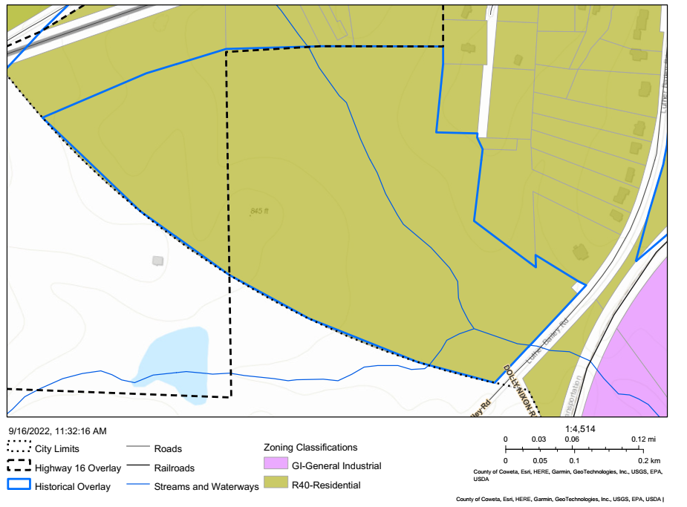
Current Zoning and Overlays
R- 40 - Requires 1 acre lots
Portion of the Property lies in the Downtown 16 Overlay
Portion of the Property lies in the Historic Overlay

