Slide 1
CITY OF SENOIA
Howard Road Rezone Proposal
(R-40) Residential – (GI) General Industrial

Slide 2
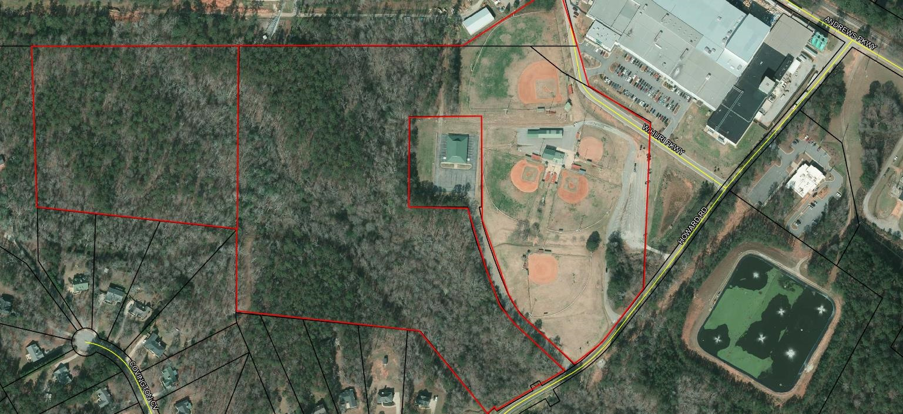
Proposed Rezone Area

Slide 3
Stream Buffer & Sewer Easement Locations

